Slide 1
Programming for Engineers in Python
Fall 2019-2020
Lecture 2: Lists & Loops

Slide 2
Last Week’s Highlights
Memory and variables
Different variable types (int, float, str, bool)
Different operations for different types
If-else statements
if expression: statement1 else: statement2

Slide 3
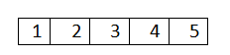
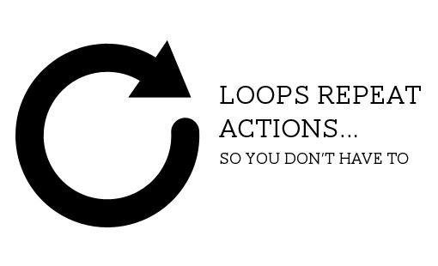
Plan for today
String Formatting
Lists
Loops
While
For

Slide 4
String Formatting
Use str.format() or the f”” syntax to format a string:
>>> name = "shahar"
>>> pi = 3.14159265359
>>> print("My name is {0} and I like {1:.2f} ".format(name, pi)) My name is shahar and I like 3.14
>>> print(f"My name is {name} and I like {pi:.2f}") My name is shahar and I like 3.14
More info: https://docs.python.org/3/library/string.html#format-examples
(Or google “python string formatting”!)

Slide 5
Lists
A list is an ordered sequence of elements.
Create a list in Python:
>>> my_list = [2, 3, 5, 7, 11]
>>> my_list
[2, 3, 5, 7, 11]

Slide 6
Lists are Indexable
Remember this?
The same indexing + slicing we saw for strings, also work for lists!
 | H |  | e |  | l |  | l |  | o
 | 0 |  | 1 |  | 2 |  | 3 |  | 4 |  | 5
 | -5 |  | -4 |  | -3 |  | -2 |  | -1

Slide 7
Lists are Indexable
>>> my_list = [2, 3, 5, 7, 11]
>>> my_list[0]
2
>>> my_list[4]
11
>>> my_list[-3]
5
>>> my_list[5]
Traceback (most recent call last):
File "<pyshell#1>", line 1, in <module>
my_list[5]
IndexError: list index out of range
[
]
11 | 7 | 5 | 3 | 2
4 | 3 | 2 | 1 | 0
-1 | -2 | -3 | -4 | -5

Slide 8
Slicing
Slicing format: list_name[from : to : step(optional)]
>>> my_list = [1,2,3,4,5,6,7,8,9,10]
>>> my_list[1:5] # slicing
[2, 3, 4, 5]
>>> my_list[0:-1] # forward/backward indexing
[1, 2, 3, 4, 5, 6, 7, 8, 9]
>>> my_list[::2] # add a step
[1, 3, 5, 7, 9]
 | 1 |  | 2 |  | 3 |  | 4 |  | 5 |  | 6 |  | 7 |  | 8 |  | 9 |  | 10
 | 0 |  | 1 |  | 2 |  | 3 |  | 4 |  | 5 |  | 6 |  | 7 |  | 8 |  | 9 |  | 10
 | -10 |  | -9 |  | -8 |  | -7 |  | -6 |  | -5 |  | -4 |  | -3 |  | -2 |  | -1

Slide 9
Slicing
# reverse
>>> my_list[::-1]
[10, 9, 8, 7, 6, 5, 4, 3, 2, 1]
# output is an empty list. This is NOT an error
>>> my_list[3:8:-2]
[]
# slicing does NOT change original list!
>>> my_list
[1, 2, 3, 4, 5, 6, 7, 8, 9, 10]

Slide 10
Slicing
To get a sliced list we need to store it:
>>> my_list = [1, 2, 3, 4, 5]
>>> new_list = my_list[::2]
>>> new_list
[1, 3, 5]
>>> my_list
[1, 2, 3, 4, 5]

Slide 11
Lists
Lists can contain strings:
>>> days = ["Sun", "Mon", "Tue", "Wed", \ "Thu", "Fri", "Sat"]
>>> days[3]
'Wed'
>>> len(days)
7
Lists can mix different types:
>>> pi = ['pi', 3.14159, True]
# student: name, age, height, SAT
>>> student = ['Roy', 21, 1.83, 782]

Slide 12
Lists – Dynamic
Maintain a list of the students either by name or by id:
>>> students = ['Itay','Roy', 'Alon', 'Zohar', 'Danielle']
>>> students[2]
'Alon'
Michal decided to join the course, so we update the list:
# append - adds an element to the end of the list
>>> students.append('Michal')
>>> students
['Itay', 'Roy', 'Alon', 'Zohar', 'Danielle', 'Michal']

Slide 13
Lists – Dynamic
Alon wants to leave the course:
>>> students.remove('Alon')
>>> students
['Itay', 'Roy', 'Zohar', 'Danielle', 'Michal']
remove removes only the first occurrence of a value.

Slide 14
Lists – Dynamic
>>> students
['Itay', 'Roy', 'Zohar', 'Daniellle', 'Michal']
>>> x = students.pop(2)
>>> students
['Itay', 'Roy', 'Danielle', 'Michal']
>>> x
'Zohar'
pop removes an item by its index (or removes the last element if index is omitted) and returns the item.
Comment: there is no obligation to "catch“ the item and
assign it to a variable.

Slide 15
Nested Lists
>>> mat = [[1, 2, 3], [4, 5, 6]]
>>> mat[1]
[4, 5, 6]
>>> mat[1][2]
6
>>> len(mat)
2
This is a list!

Slide 16
Nested Lists
>>> family = ['Meir',
['Yossi',
['Yuval',
['Gilit']]],
['Shoshana',
['Meir'], ['Orna'], ['Evyatar']],
['Gavri',
['Uri'], ['Boaz']]]

Slide 17
Range
range() returns an iterator with ordered integers in the given range (Iterator is an object that generates elements upon request, and not in advance).
>>> range(10)
range(0, 10)
>>> list(range(10))
[0, 1, 2, 3, 4, 5, 6, 7, 8, 9]
range(from, to) contains all integers k satisfying from ≤ k < to.
range(to) is a shorthand for range(0, to).
>>> list(range(2,10))
[ 2, 3, 4, 5, 6, 7, 8, 9]
>>> list(range(-2,2))
[-2, -1, 0, 1]
>>> list(range(4,2))
[]

Slide 18
Range
>>> type(range(3))
<class 'range'>
Step size:
range(from, to, step) returns:
from, from+step, from+2*step,…, from+i*step
until to is reached, not including to itself.
>>> list(range(0,10,2))
[0, 2, 4, 6, 8]
>>> list(range(10,0,-2))
[10, 8, 6, 4, 2]

Slide 19
Range
>>> list(range(0, 10, -1))
[]
>>> range(0,10,0)
Traceback (most recent call last):
File "<pyshell#4>", line 1, in <module>
range(0,10,0)
ValueError: range() arg 3 must not be zero

Slide 20
Sorting a list
sorted(lst) creates a sorted copy of lst:
>>> a = [5, 2, 3, 1, 4]
>>> b = sorted(a)
>>> b
[1, 2, 3, 4, 5]
>>> a
[5, 2, 3, 1, 4]
a wasn’t changed
lst.sort() sorts lst itself (in-place):
>>> c = [5, 2, 3, 1, 4]
>>> c.sort()
>>> c
[1, 2, 3, 4, 5]
c was changed

Slide 21
Sorting a list (cont.)
What would happen if we sort with key=str.lower
>>> l = '123 this is a simple check'.split()
>>> l
['123', 'this', 'is', 'a', 'simple', 'check']
>>> sorted(l)
['123', 'a', 'check', 'is', 'simple', 'this']
>>> sorted(l, key=len)
['a', 'is', '123', 'this', 'check', 'simple']
Splits a string to words (tokens) based on default delimiters. Returns a list of strings.
Optional parameter specifying a function to be applied on each list element before sorting.
Also applicable for l.sort(key=…)

Slide 22
Summary of List Methods
Function | Description
lst.append(item) | append an item to the end of the list
lst.count(val) | return the number of occurrences of val
lst.extend(another_lst) | extend list by appending items from another list
lst.index(val) | return first index of val
lst.insert(index, item) | insert an item before index
lst.pop(index) | remove the item at location index and return it (remove last element if index is omitted)
lst.remove(val) | remove first occurrence of a val
lst.reverse() | reverse the list (in place)
lst.sort() | sort the list (in place)
These are “queries that do not change the list
Comment: All commands are applied to an existing list named lst

Slide 23
Useful functions on lists
len() – returns the list’s length
sum() – returns a sum of all list elements
min() – returns the minimal element
max() – returns the maximal element
in – returns True if element in list

Slide 24
Lists documentation
Complete documentation on Python lists is available at:
https://docs.python.org/3/tutorial/datastructures.html

Slide 25
Plan for today
String Formatting
Lists
Loops
While
For

Slide 26
Algorithms and Pseudo Codes
How can I get to the university in the morning?

Slide 27
Algorithms and Pseudo Codes
How can I get to the university in the morning?
Get up
Drink coffee if there is time
Get out of the house
Walk for four blocks
While waiting for the bus:
play 'Clash of Clans'
text friends
6. Get on the bus
…

Slide 28
Think First, Code Later
How can I get to the university in the morning?
Get up
Drink coffee if there is time
Get out of the house
Walk for four blocks
While waiting for the bus:
play ‘Clash of Clans’
text friends
6. Get on the bus
…

Slide 29
While Loop
Used to repeat the same instructions until a stop criterion is met
while expression:
statement1
statement2
…
rest of code…
expression
false
true
statement(s)

Slide 30
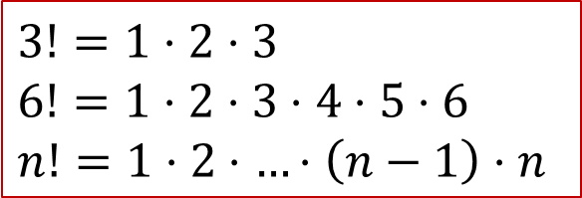
Example - factorial
#factorial
n = 7
fact = 1
i = 1
while i <= n:
fact = fact * i
i = i + 1
print(n, '! =', fact)
$$3!=1⋅2⋅3$$
$$6!=1⋅2⋅3⋅4⋅5⋅6$$
$$n!=1⋅2⋅…⋅\left(n−1\right)⋅n$$

Slide 31

Example – smallest divisor
# Find the smallest divisor
n = 2019
div = 2
while n % div != 0:
div = div + 1
print("Smallest divisor of", n, "is", div)
Can the while loop above be infinite?
$$10→2$$
$$221→13$$

Slide 32

Infinite Loops
i = 1
while i < 4:
print(i)

Slide 33
Plan for today
String Formatting
Lists
Loops
While
For

Slide 34
For Loop
for element in iterable:
statement1
statement2
…
rest of code…
Run over all elements in iterable (list, string, etc.)
Iteration 0: Assign element = iterable[0]
Execute statement1, statement2, …
Iteration 1: Assign element = iterable[1]
Execute statement1, statement2, …
…
Variable element is defined by the loop!

Slide 35
For Loop
Indentation determines the block of the iteration.
Note
No infinite lists in Python →
No infinite for loops! (at least in this course…)

Slide 36
For Example
print elements from a list
lst = ['python', 2019, 'TAU']
for elem in lst:
print("current element:", elem)
current element: python
current element: 2019
current element: TAU

Slide 37
For Example
Compute 1 + 2 + … + 100:
partial_sum = 0
numbers = range(1,101)
for num in numbers:
partial_sum = partial_sum + num
print("The sum is", partial_sum)
The sum is 5050
Or simply:
sum(range(1,101))
1, 2, …, 100

Slide 38

For Example
# factorial
n = 7
fact = 1
for i in range(2, n+1):
fact = fact * i
print(n, "! =", fact)
Syntactic sugar:
fact *= i is equivalent to fact = fact * i
# reminder
n = 7
fact = 1
i = 1
while i <= n:
fact = fact * i
i = i + 1
2, 3, …, n

Slide 39
List Comprehension
Pythonic way of creating lists.
Combining lists and for loops.
Syntax:
[expression for item in list]
We can even write:
[expression for item in list if condition]

Slide 40
List Comprehension - Example
Instead of
>>> my_list = [] >>> for i in range(10): my_list.append(i*i) >>> my_list [0, 1, 4, 9, 16, 25, 36, 49, 64, 81]
We can simply write
>>> my_list = [i**2 for i in range(10)] >>> my_list [0, 1, 4, 9, 16, 25, 36, 49, 64, 81]

Slide 41
List Comprehension
More examples:
>>> [2**i for i in range(10)]
[1, 2, 4, 8, 16, 32, 64, 128, 256, 512]
>>> [1 for i in range(10)] # same as [1]*10
[1, 1, 1, 1, 1, 1, 1, 1, 1, 1]
>>> [i for i in range(10) if (i%3==0 or i%4==0)]
[0, 3, 4, 6, 8, 9]

Slide 42
List Comprehension
More examples:
>>> l = ['The', 'quick', 'brown', 'fox', 'jumps', 'over', 'the', 'lazy', 'dog']
>>> [word.upper() for word in l]
['THE', 'QUICK', 'BROWN', 'FOX', 'JUMPS', 'OVER', 'THE', 'LAZY', 'DOG']
>>> [word for word in l if len(word) < 4]
['The', 'fox', 'the', 'dog']

Slide 43
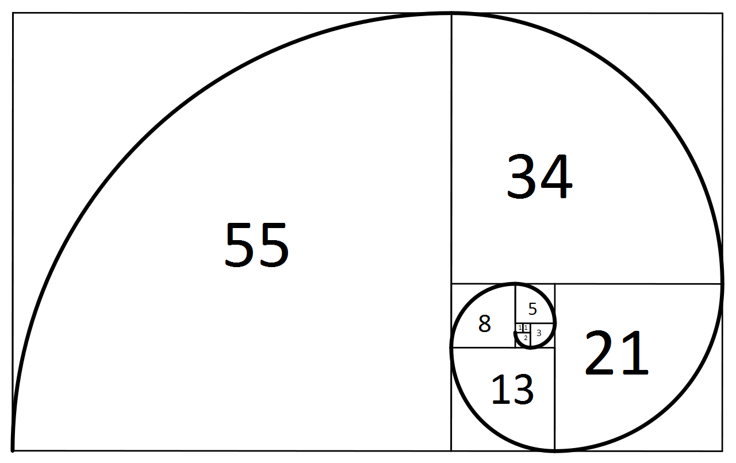
Fibonacci series

Slide 44

Fibonacci series

Slide 45
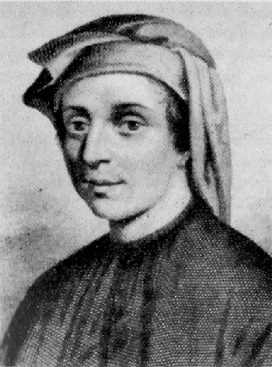
Fibonacci series
Fibonacci series
1, 1, 2, 3, 5, 8, 13, 21, 34
Definition
fib(1) = 1
fib(2) = 1
fib(n) = fib(n-1) + fib(n-2)
en.wikipedia.org/wiki/Fibonacci_number
Leonardo Fibonacci
1170-1250, Italy

Slide 46
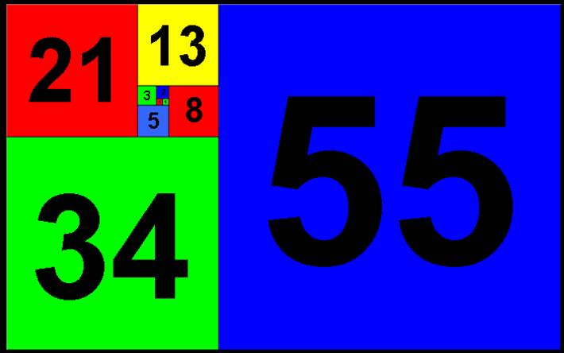
Fibonacci series
Write a program that for any integer n > 0,
prints the n^{th} Fibonacci number.

Slide 47
Fibonacci series - code
n = 10
if n <= 2:
curr = 1
else:
prev = 1
curr = 1
for i in range(3, n+1):
new = prev + curr
prev = curr
curr = new
print("The", n, "Fibonacci number is", curr)

Slide 48

For Loop and Strings
We can iterate also over strings:
name = "Kobe"
for letter in name:
print("Give me", letter)
print("What did we get?", name)
Give me K
Give me o
Give me b
Give me e
What did we get? Kobe

Slide 49

Break – breaking loops
break terminates the nearest enclosing loop, skipping the code that follows the break inside the loop.
Used for getting out of loops when a condition occurs.
Example:
lst = [4, 2, -6, 3,-9]
for elem in lst:
if elem < 0:
print("First negative number is", elem)
break
First negative number is -6

Slide 50
Break Example
# Find smallest divisor using for loop:
n = … # some number
for div in range(2, n+1):
if n % div == 0:
break
print(div)

Slide 51
Example - Prime
Check if a number is prime:
n = 2019
for div in range(2,n):
if n % div == 0:
break
if n % div == 0:
print(n, "is not prime")
else:
print(n, "is prime")
Must we iterate up to n?

Slide 52
Example - Prime
Optimization:
n = 2019
for div in range(2,int(n**0.5)):
if n % div == 0:
break
if n % div == 0:
print(n, "is not prime")
else:
print(n, "is prime")
range must accept argument of the type int so we perform casting on the result of the power operation.

Slide 53
Where is the bug?...
n = ???
for div in range(2,int(n**0.5)):
if n % div == 0:
break
if n % div == 0:
print(n, "is not prime")
else:
print(n, "is prime")

Slide 54
Where is the bug?...
n = ???
for div in range(2,int(n**0.5)+1):
if n % div == 0:
break
if n % div == 0:
print(n, "is not prime")
else:
print(n, "is prime")

Slide 55

Continue
The continue statement, continues with the next iteration of the loop.
Example - create a list of unique elements:
lst = [1,4,5,8,3,5,7,1,2]
uniques = []
for x in lst:
if x in uniques:
continue
uniques.append(x)
print(uniques)
[1, 4, 5, 8, 3, 7, 2]

Slide 56
for or while?
In most cases it is more natural to use for
In some cases it is better to use while
for:
Predefined number of iterations
No need to initialize or advance the loop variable
while:
Unknown number of iterations
Can specify a stop condition

Slide 57
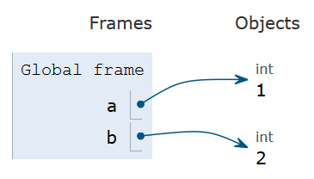
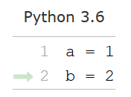
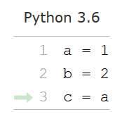
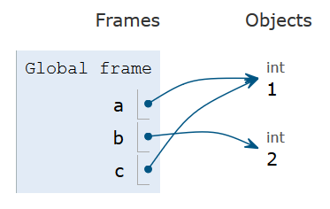
What really happens in memory?
Example – Assignments in Python
a, b and c are name variables which point to the locations in memory (objects) where their values are stored.
The assignment a=1 creates both a name-variable a, and an object of type int which is being pointed by a, and stores the value 1.
Created by pythontutor.com

Slide 58
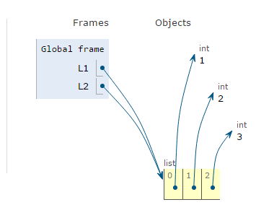
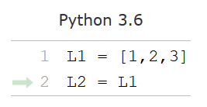
Example – Assignments in Python
Created by pythontutor.com

